Slide 1
Slaviša Đurđić
Significant Volcanic Eruptions
Goal: Analysis of the Tableau “Significant Volcanic Eruptions” science data sample dataset with Looker Studio.
Instructions:
- Collect data by downloading the Excel file from https://public.tableau.com/app/learn/sample-data?qt-overview_resources=1#qt-overview_resources.
- Connect to the file from Looker Studio and build visuals (https://lookerstudio.google.com/reporting/5c23c74e-1648-473c-ac91-0db44aed4f29/page/p_aa4ug29lad).
Belgrade, October 2023

Slide 2
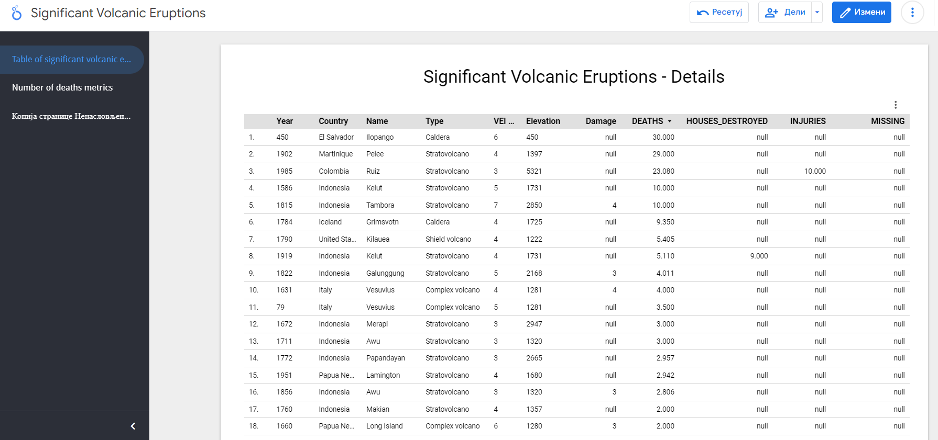

Slide 3
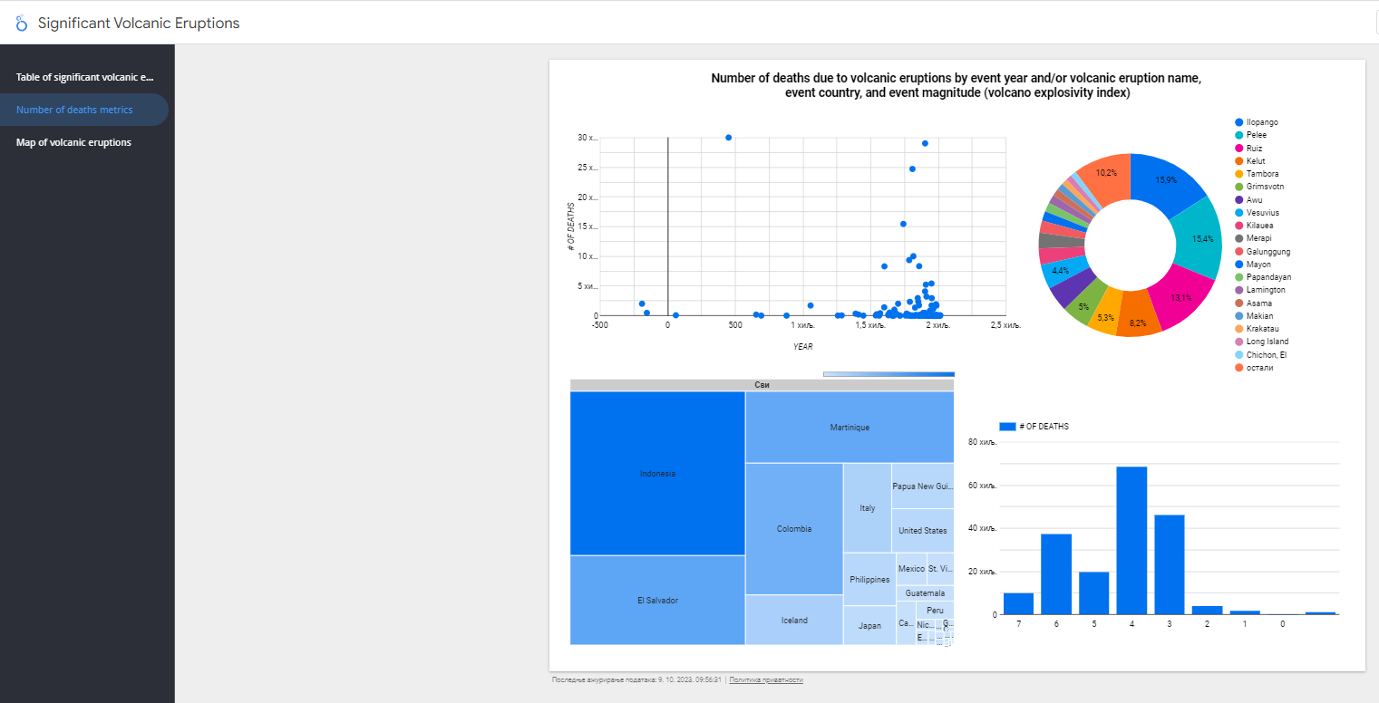

Slide 4
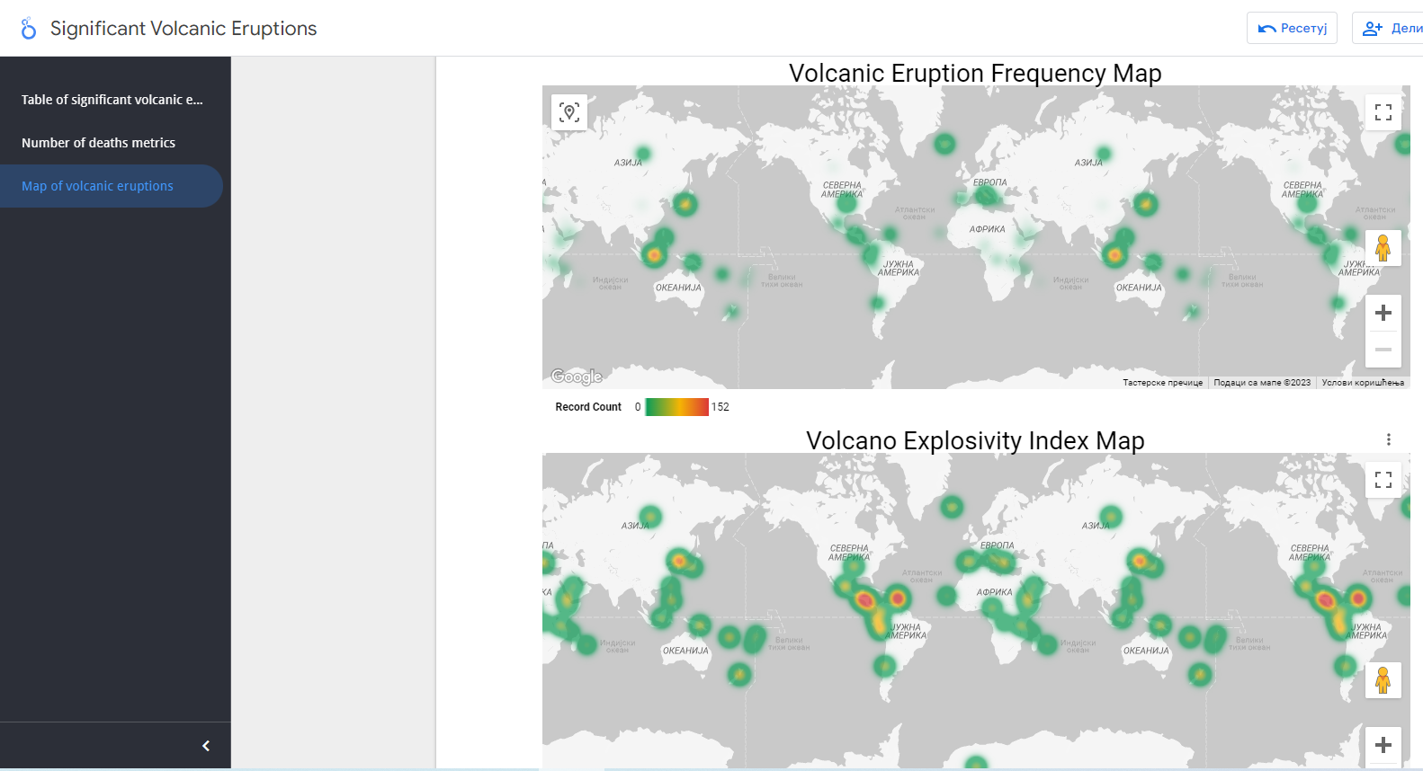

Slide 5
Significant Volcanic Eruptions Project Insights
Ilopango – a powerful volcanic eruption of magnitude of 6, was the most tragic volcanic eruption in history with 30K deaths. It happened in 5th century in El Salvador.
Indonesia is the country with the most scored number of deaths due to volcanic eruptions – more than 55K deaths. The most serious one was called Kelut that counts more than 15K deaths. It happened on two different occasions (16th and 20th centuries).
Three strongest volcanic eruptions, measuring VEI of 7, were Tambora, Changbaishan, and Kikai. Tambora hit Indonesia in year 1815, and among those three, it is the only one with victims – 10K deaths.
Indonesia appears to be the area with most volcanic activities. Japan seems to be the second, and Iceland on the third place.
Area around Caribbean sea records the strongest volcanic eruptions on average.

